Slide 1


Italian Hotels Management System
By Mohannad, Hashim

Slide 2
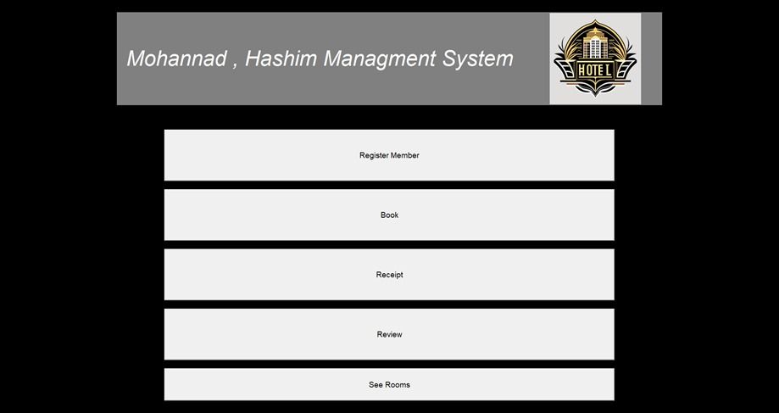
The GUI menu of the management system has 5 buttons, every button has its own purpose when you click it.

Slide 3

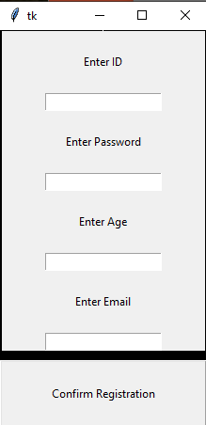

Starting with the Register Member button:
The "Register Member" button facilitates the registration of new members into the hotel management system. When clicked, it invokes the corresponding function, likely housed within the HotelManagementSystem class. This functionality is crucial for maintaining a database of members, enabling personalized services and streamlining communication with the hotel clientele.

Slide 4
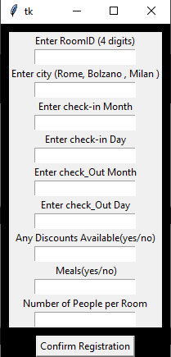

Booking Button:The "Book" button initiates the room booking process within the hotel management system. Upon clicking, users can input details such as the desired room type, check-in/out dates, and guest information. This button likely triggers the InputBooking function, allowing seamless reservation handling and efficient management of room occupancy.

Slide 5
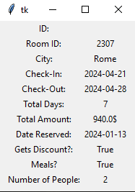

Receipt Button:Clicking the "Receipt" button generates a receipt for a completed booking. This function, likely part of the HotelManagementSystem class, retrieves relevant information about the booking and formats it into a receipt. Providing guests with a detailed receipt enhances transparency and customer satisfaction, contributing to a positive hotel experience.

Slide 6
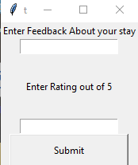

Review Button: The "Review" button is associated with the submission of reviews by guests. Upon clicking, users can share their feedback, opinions, and ratings about their stay. This feature, implemented through the Forms.SubmitReview function, allows the hotel to gather valuable insights, address concerns, and maintain a high standard of service.

Slide 7
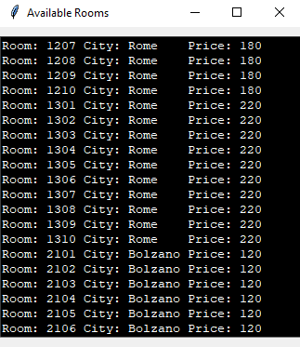

See Rooms Button: The "See Rooms" button offers users the ability to view the available rooms within the hotel. When clicked, it opens a new window displaying information retrieved from the "Hotel_Info.txt" file. This functionality, likely encapsulated in the room_options method of the HotelManagementSystem class, provides transparency to potential guests regarding room options, pricing, and availability.

